Slide 1

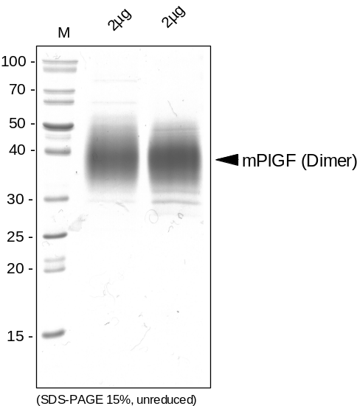
ReliaTech GmbH
Recombinant mouse PlGF
(Cat #M30-019S / -019 / -020)
Fig. 1: SDS-PAGE analysis of recombinant mouse PlGF. Samples were loaded in 15% SDS-polyacrylamide gel under non-reducing conditions and stained with Silver stain.
http://www.reliatech.de / orders@reliatech.de

